Slide 1
Software Design and Architecture
Command and Template Patterns

Slide 2
Design principles
High-level principles
‣ Single Responsibility
‣ Open/Closed
‣ Liskov Substitution Principle
‣ Interface Segregation
‣ Dependency Inversion
Low-level principles
‣ Encapsulate what varies
‣ Program to interfaces, not implementations
‣ Favor composition over inheritance
‣ Strive for loose coupling

Slide 3
Command
Behavioral Patterns
observer
decorator
strategy
command
Creational Patterns
factory method
abstract factory
singleton

Slide 4
Problem
Your program is in charge of all action events, implementing these would lead to huge if-elseif or switch blocks.

Slide 5
public void actionPerformed(ActionEvent e)
{
Object o = e.getSource();
if (o instanceof fileNewMenuItem)
doFileNewAction();
else if (o instanceof fileOpenMenuItem)
doFileOpenAction();
else if (o instanceof fileOpenRecentMenuItem)
doFileOpenRecentAction();
else if (o instanceof fileSaveMenuItem)
doFileSaveAction();
// and more ...
}

Slide 6
Command Pattern solution
public interface Command
{
public void execute();
}
public class FileOpenMenuItem extends JMenuItem implements Command
{
public void execute()
{
// your business logic goes here
}
}
public void actionPerformed(ActionEvent e)
{
Object o = e.getSource();
if (o instanceof fileNewMenuItem)
doFileNewAction();
else if (o instanceof fileOpenMenuItem)
doFileOpenAction();
else if (o instanceof fileOpenRecentMenuItem)
doFileOpenRecentAction();
else if (o instanceof fileSaveMenuItem)
doFileSaveAction();
// and more ...
}
public void actionPerformed(ActionEvent e)
{
Command command = (Command)e.getSource();
command.execute();
}

Slide 7
Command Pattern
Move the code for each individual action into it’s own separate class.
Each of these classes implements the same Interface, allowing the code that uses them to interact solely with the Interface and not know or care about the individual classes.
This increases Cohesion because each class is responsible for one discrete set of logic.
This decreases Coupling because the code calling the command only deals with one type, the Interface.

Slide 8
Command Pattern
The Command Pattern encapsulates a request as an object, thereby letting
you parameterize other objects with different requests, queue or log requests,
and support undoable operations

Slide 9
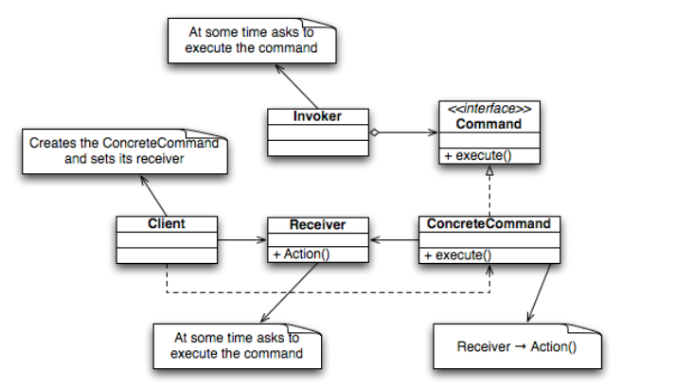
Command Pattern

Slide 10
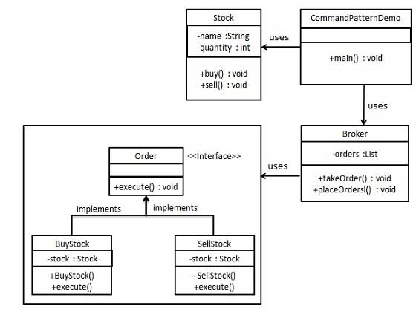
Command Pattern
Receiver
Client
Invoker
Command

Slide 11
Receiver
public class Stock {
private String name = "ABC";
private int quantity = 10;
public void buy(){
System.out.println("Stock [ Name: "+name+",
Quantity: " + quantity +" ] bought");
}
public void sell(){
System.out.println("Stock [ Name: "+name+",
Quantity: " + quantity +" ] sold");
}
}

Slide 12
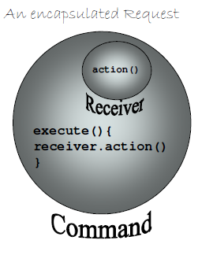
Command
public interface Order {
void execute();
}
public class BuyStock implements Order {
private Stock abcStock;//Receiver
public BuyStock(Stock abcStock){
this.abcStock = abcStock;
}
public void execute() {
abcStock.buy();
}
}
public class SellStock implements Order {
private Stock abcStock;//Receiver
public SellStock(Stock abcStock){
this.abcStock = abcStock;
}
public void execute() {
abcStock.sell();
}
}

Slide 13
Invoker
import java.util.ArrayList;
import java.util.List;
public class Broker {
private List<Order> orderList = new ArrayList<Order>();
public void takeOrder(Order order){
orderList.add(order);
}
public void placeOrders(){
for (Order order : orderList) {
order.execute();
}
orderList.clear();
}
}

Slide 14
Client
public class CommandPatternDemo {
public static void main(String[] args) {
Stock abcStock = new Stock();
BuyStock buyStockOrder = new BuyStock(abcStock);
SellStock sellStockOrder = new SellStock(abcStock);
Broker broker = new Broker();
broker.takeOrder(buyStockOrder);
broker.takeOrder(sellStockOrder);
broker.placeOrders();
}
}

Slide 15
Command Pattern
public interface Command
{
public void execute();
}
You can put any “generic” method in here:
log()
undo()
delete()
load()

Slide 16
Receiver
public class TV() {
public TV() {
system.out.println("TV Created");
}
public on() {
system.out.println("TV On");
}
public off() {
system.out.println("TV Off");
}
}

Slide 17
Command
public interface Command {
public void execute();
public void undo();
}
public class TVOnCommand implements Command {
TV tv;
public TVOnCommand(TV tv){
this.tv = tv;
}
public void execute() {
tv.on();
}
public void undo() {
tv.off()
}
}
public class TVOffCommand implements Command {
TV tv;
public TVOffCommand(TV tv){
this.tv = tv;
}
public void execute() {
tv.off();
}
public void undo() {
//undo the off
tv.on()
}
}

Slide 18
Invoker
public class SimpleRemote {
Command onButton;
Command offButton;
Command undoCommand;
public SimpleRemote() {}
public void setOnCommand(Command command) {
onButton = command;
}
public void setOffCommand(Command command) {
offButton = command;
}
// The remote doesn't care what device it's turning on, it just issues the command
// set the undo command object to the last object called
public void buttonOnWasPressed() {
onButton.execute();
undoCommand = onButton;
}
public void buttonOffWasPressed() {
offButton.execute();
undoCommand = offButton;
}
public void buttonUndoWasPressed() {
undoCommand.undo();
}
}

Slide 19
Client
public class RemoteTest {
public static void main(String[] args) {
SimpleRemote remote = new SimpleRemote();
TV tv = new TV();
TVOnCommand tvOn = new TVOnCommand(tv);
TVOffCommand tvOff = new TVOffCommand(tv);
//program the remote to turn the TV on and off
remote.setOnCommand(tvOn);
remote.setOffCommand(tvOff);
remote.buttonOnWasPressed();
remote.buttonOffWasPressed();
//turn the TV back on by undoing the off call
remote.buttonUndowWasPressed();
}
}

Slide 20
Template method
Behavioral Patterns
observer
decorator
strategy
command
template method
Creational Patterns
factory method
abstract factory
singleton

Slide 21
Problem
Duplicated code is difficult to change, maintain or extend

Slide 22
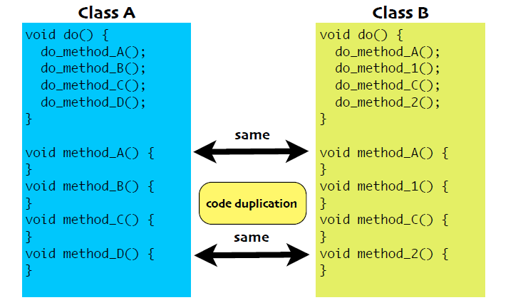
Example

Slide 23
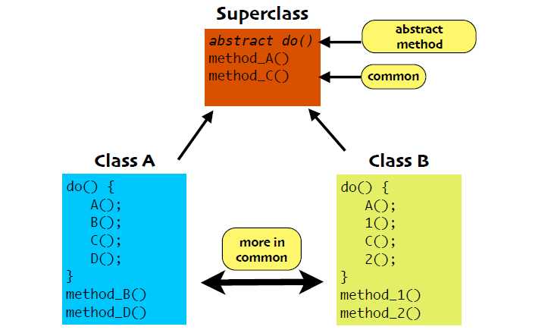
Remove Redundancy

Slide 24
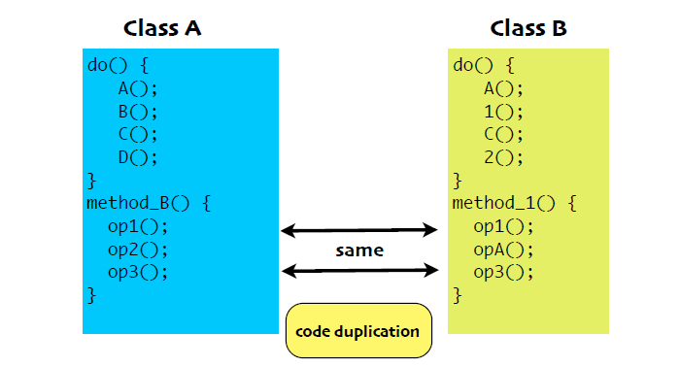
Remove Redundancy

Slide 25
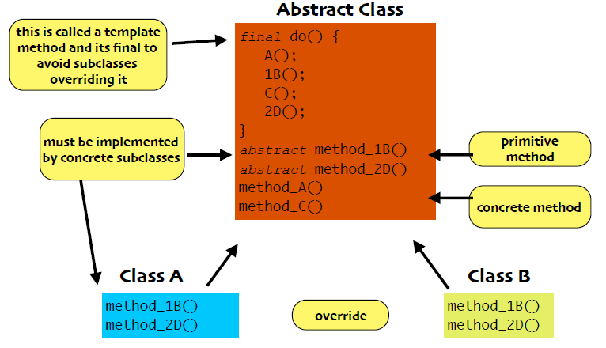
Define Template Method

Slide 26
Template Method
The Template Method Pattern
defines the skeleton of an
algorithm in a method, deferring
some steps to subclasses.

Slide 27
Code
public class Coffee {
void prepareRecipe() {
boilWater();
brewCoffeeGrinds();
pourInCup();
addSugarAndMilk();
}
public void boilWater() {
System.out.println("Boiling water");
}
public void brewCoffeeGrinds() {
System.out.println("Dripping Coffee through filter");
}
public void pourInCup() {
System.out.println("Pouring into cup");
}
public void addSugarAndMilk() {
System.out.println("Adding Sugar and Milk");
}
}
public class Tea {
void prepareRecipe() {
boilWater();
steepTeaBag();
pourInCup();
addLemon();
}
public void boilWater() {
System.out.println("Boiling water");
}
public void steepTeaBag() {
System.out.println("Steeping the tea");
}
public void addLemon() {
System.out.println("Adding Lemon");
}
public void pourInCup() {
System.out.println("Pouring into cup");
}
}

Slide 28
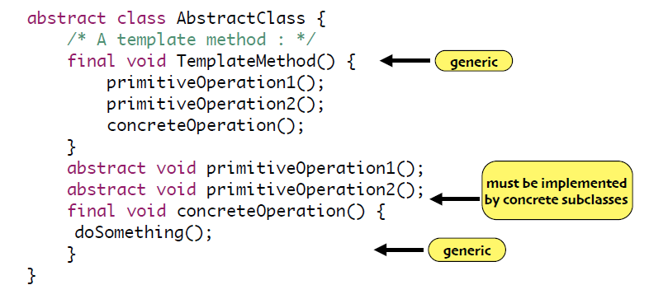
Code

Slide 29
Code
public abstract class CaffeineBeverage {
final void prepareRecipe() {
boilWater();
brew();
pourInCup();
addCondiments();
}
abstract void brew();
abstract void addCondiments();
void boilWater() {
System.out.println("Boiling water");
}
void pourInCup() {
System.out.println("Pouring into cup");
}
}
public class Coffee extends CaffeineBeverage {
public void brew() {
System.out.println("Dripping Coffee through filter");
}
public void addCondiments() {
System.out.println("Adding Sugar and Milk");
}
}
public class Tea extends CaffeineBeverage {
public void brew() {
System.out.println("Steeping the tea");
}
public void addCondiments() {
System.out.println("Adding Lemon");
}
}

Slide 30
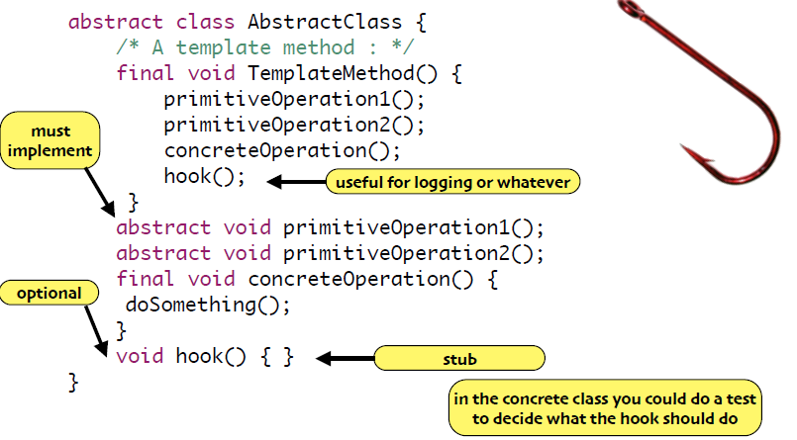
Add a Hook

Slide 31
Code
public abstract class CaffeineBeverageWithHook {
void prepareRecipe() {
boilWater();
brew();
pourInCup();
if (customerWantsCondiments()) {
addCondiments();
}
}
abstract void brew();
abstract void addCondiments();
void boilWater() {
System.out.println("Boiling water");
}
void pourInCup() {
System.out.println("Pouring into cup");
}
boolean customerWantsCondiments() {
return true;
}
}
prepareRecipe() altered to have
a hook method:
customerWantsCondiments()
This method provides a method
body that subclasses can override
To make the distinction between
hook and non-hook methods
more clear, you can add the
“final” keyword to all concrete
methods that you don’t want
subclasses to touch

Slide 32
Code
import java.io.*;
public class CoffeeWithHook extends CaffeineBeverageWithHook {
public void brew() {
System.out.println("Dripping Coffee through filter");
}
public void addCondiments() {
System.out.println("Adding Sugar and Milk");
}
public boolean customerWantsCondiments() {
String answer = getUserInput();
if (answer.toLowerCase().startsWith("y")) {
return true;
} else {
return false;
} }
private String getUserInput() {
String answer = null;
System.out.print("Would you like milk and sugar with your coffee (y/n)? ");
BufferedReader in = new BufferedReader(new InputStreamReader(System.in));
try {
answer = in.readLine();
} catch (IOException ioe) {
System.err.println("IO error trying to read your answer");
}
if (answer == null) {
return "no";
}
return answer;
} }

Slide 33
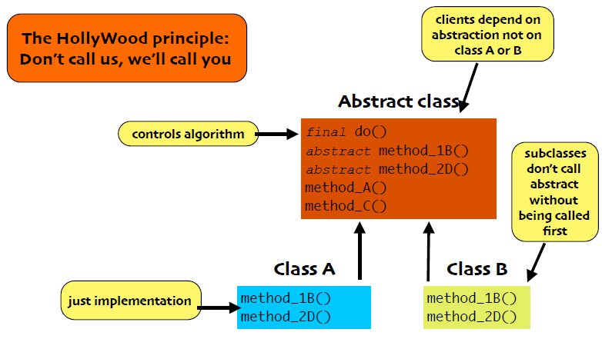
Design Principle

Slide 34
Hollywood Principle
“Don’t call us, we’ll call you”
When we design with the template method pattern, we are telling subclasses “Don’t call us, we’ll call you”
The template method lives in a high-level class and invokes methods that live in its subclasses:
The CaffeineBeverage has control over the algorithm for the recipe. It calls on subclasses only when they are needed for an implementation of a method.

Slide 35
Template Methods in the Wild
Template Method is used a lot since it’s a great design tool for creating frameworks
the framework specifies how something should be done with a template method
that method invokes abstract hook methods that allow client-specific subclasses to “hook into” the framework and take advantage of its services
Examples in the Java API
Sorting using compareTo() method
Frames in Swing
Applets

Slide 36
Template Method vs. Strategy
Both Template Method and Strategy deal with the encapsulation of algorithms
Template Method focuses encapsulation on the steps of the algorithm
Strategy focuses on encapsulating entire algorithms
You can use both patterns at the same time if you want

Slide 37
Template Method vs. Strategy
Template Method encapsulate the details of algorithms using inheritance
Factory Method can now be seen as a specialization of the Template Method pattern
In contrast, Strategy does a similar thing but uses composition/delegation

Slide 38
Template Method vs. Strategy
Because it uses inheritance, Template Method offers code reuse benefits not typically seen with the Strategy pattern
On the other hand, Strategy provides run-time flexibility because of its use of composition/delegation
You can switch to an entirely different algorithm when using Strategy, something that you can’t do when using Template Method

Slide 39
Inclass Exercise
CQRS (Command and Query Responsibility Segregation) Architecture

